Slide 1
CONTENTS
1.Block Diagram = 03
2.Signal components = 04
3.Working principle = 05
4.Measuring the distance = 06
5. Simulation = 07
6. Graphical = 08
7. Waypoint mapping = 09

Slide 2
BLOCK DIAGRAM:
FMCW Signal
Target
Detection
No Object Detected
Detected
Visualizing (Processing)

Slide 3
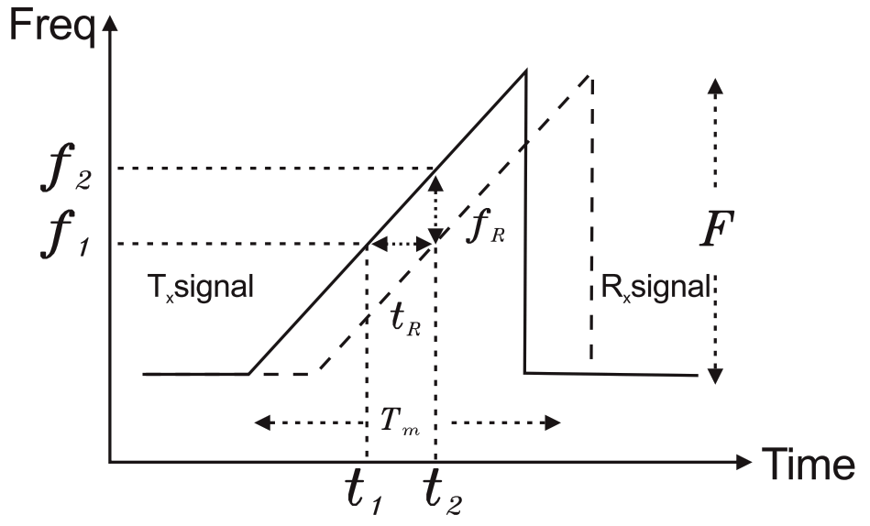
FMCW (Frequency modulated continuous wave)

Slide 4
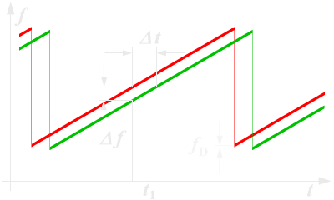
WORKING PRINCIPLE:
FMCW radar is a special type of radar sensor which radiates continuous transmission power like a simple continuous wave radar. In contrast to this CW radar FMCW radar can change its operating frequency during the measurement: that is, the transmission signal is modulated in frequency (or in phase).

Slide 5
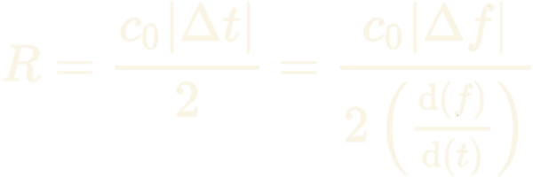
MEASURING THE DISTANCE:
The distance measurement is accomplished by comparing the frequency of the received signal to a reference (usually directly the transmission signal).
The duration of the transmitted waveform T is substantially greater than the required receiving time for the installed distance measuring range.
c₀ = speed of light = 3·10^{8 m}/_{s}
Δt = delay time [s]
Δf = measured frequency difference [Hz]
R = distance between antenna and the reflecting object (ground) [m]
df/dt = frequency shift per unit of time

Slide 6
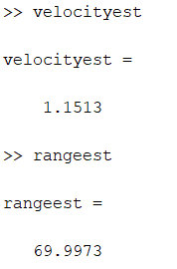
SIMULATION:
Lets assume the moving vehicle properties,
Car speed = 90Km/hr
Car distance = 70m

Slide 7
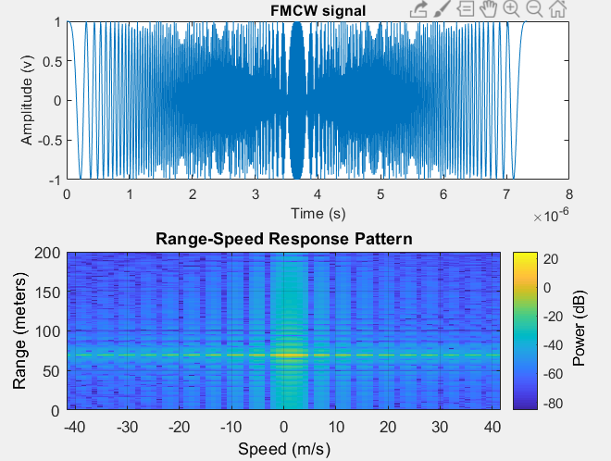
Graphical Output:

Slide 8

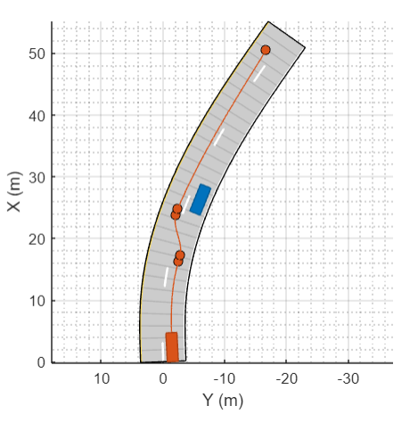
Waypoint Mapping:

